Slide 1
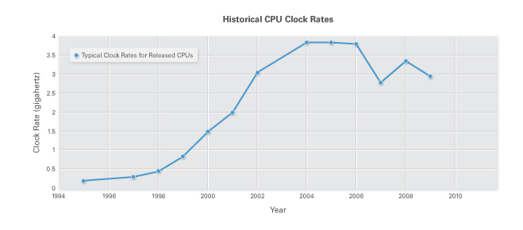
Technologies for Network-Based Systems
Multi-core CPUs and Multithreading Technologies
CPU’s today assume a multi-core architecture with dual, quad, six, or more processing cores.
The clock rate increased from 10 MHz for Intel 286 to 4 GHz for Pentium 4 in 30 years.
However, the clock rate reached its limit on CMOS chips due to power limitations,excessive heat generation and current leakage.
Multi-core CPUs can handle multiple instruction threads.

Slide 2
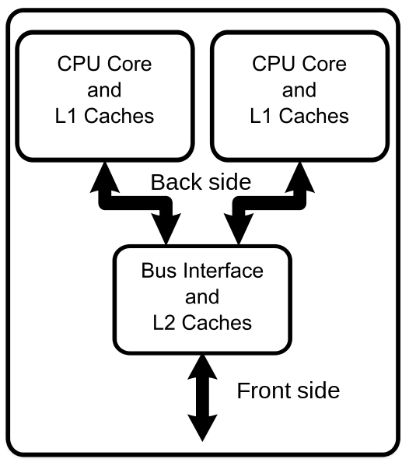
Technologies for Network-Based Systems
Multi-core CPUs and Multithreading Technologies
LI cache is private to each core, L2 cache is shared and L3 cache or DRAM is off the chip.
Examples of multi-core CPUs include Intel i7, Xeon, AMD
Each core can also be multithreaded. E.g. the Niagara II has 8 cores with each core handling 8 threads
Notes:
You can see a gain anywhere from 40% to 70% (up to a maximum of 90%) in performance by adding additional cores. But this depends on whether the code can be parallelized or if it mainly serialized and also on the memory and bus bottlenecks that might be the constraint.

Slide 3
Technologies for Network-Based Systems
Memory, Storage and WAN
DRAM chip capacity increased from 16 KB in 1976 to 64 GB in 2011 for a 4x increase in capacity every 3 years..
For hard drives, capacity increased from 260 MB in 1981 to 3 TB in 2011 for an approximate 10x increase in capacity every 8 years.
The "memory wall" is the growing disparity of speed between CPU and memory outside the CPU chip. CPU speed improved at an annual rate of 55% while memory speed only improved at 10%.
The memory wall may become an even worse problem limiting CPU performance.

Slide 4
Technologies for Network-Based Systems
System-Area Interconnects
A LAN is typically used to connect clients to big servers.
A Storage Area Network (SAN) connects servers to network storage such as disk arrays.
Network attached storage (NAS) connects servers directly to disk arrays.
Notes:
The SAN’s storage usually consists of several large arrays of high-speed (serial attached SCSI) SAS disks spinning at up to 15,000 rpm, although solid-state disks are used in situations where performance or energy saving are priorities.
SANs are used for mission-critical data such as big databases, and reliability and performance are key. SANs need to be fast and transparent to the operating system even though the data may travel some distance from the server.
The development of SANs was in part a solution to the problem of slow access to network-attached storage. However, with faster 10Gb Ethernet becoming a standard in the datacentre, we are seeing more convergence between SAN and NAS. Most vendors are offering combined storage systems, available either via block access over Fibre Channel or using file-level access, a trend that is likely to accelerate as 40Gb and 100Gb Ethernet enter the mainstream. Fibre Channel over Ethernet looks set to become the de facto standard for storage over the next decade.
Convergence offers a big advantage if you are managing datacentre storage because you will no longer need to manage, back up and balance data across two separate storage systems. However, if you need to choose between SAN and NAS, the key difference to focus on is whether or not you need the top performance and reliability of a SAN and are prepared to pay the premium. If not, you need a NAS

Slide 5
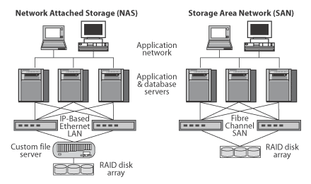
Technologies for Network-Based Systems
System-Area Interconnects - NAS
A NAS is fundamentally a bunch of disks, usually arranged in a disk array. Users and servers attach to the NAS primarily using TCP/IP over Ethernet, and the NAS has its own IP address. The primary job of a NAS is to serve files, so most NAS systems offer support for Windows networking, HTTP, plus file systems and protocols such as NFS .
Notes:
One way to loosely conceptualize the difference between a NAS and a SAN is that a NAS appears to the client OS (operating system) as a file server (the client can map network drives to shares on that server) whereas a disk available through a SAN still appears to the client OS as a disk, visible in disk and volume management utilities (along with client's local disks), and available to be formatted with a file system and mounted.

Slide 6
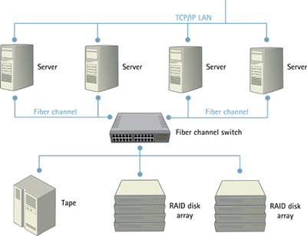
Technologies for Network-Based Systems
System-Area Interconnects - SAN
SAN and network-attached storage (NAS) are both network-based storage solutions. A SAN typically uses Fibre Channel connectivity, while NAS typically ties into to the network through a standard Ethernet connection. A SAN stores data at the block level, while NAS accesses data as files.

Slide 7
Technologies for Network-Based Systems
Virtual Machines and Virtualization Middleware
To build clouds we need to aggregate large amounts of computing, storage, and networking resources in a virtualized manner. Specifically clouds rely on the dynamic virtualization of CPU, memory, and I/O.
Virtual Machines (VMs)
The VM is built with virtual resources managed by a guest OS to run a specific application.
Between the VMs and the host platform, a middleware layer (called the Virtual Memory Monitor (VMM) or a hypervisor) is deployed.
Type 1 (bare metal) hypervisor
  The bare metal hypervisor runs on the bare hardware and handles all the
  Hardware (CPU, memory, and I/O) directly. This runs in the privileged
  mode. The guest OS could any OS such as Linux, Windows etc.
Notes:
With Type-1, the hypervisor is master, it controls the OSes (called “guests”). With Type-2, the master is an OS (the one which hosts the hypervisor), it controls the hypervisor, which can only control the other OSes.

Slide 8
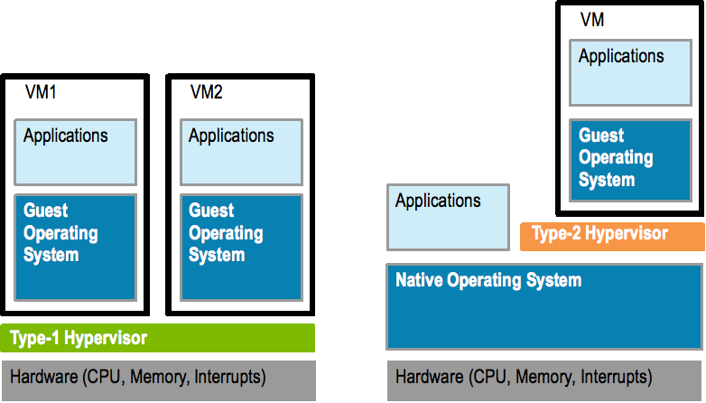
Technologies for Network-Based Systems
Virtual Machines and Virtualization Middleware
Type 1 (hosted) hypervisor (continued)
Bare-metal is great for consolidating a company’s collection of servers onto a single piece of hardware.
Some examples of the leading bare-metal hypervisors are VMware’s ESX(i) (proprietary), Citrix Xen Server (FOS (Free & Open Source)), and KVM (kernel loaded VM) (FOS). ESX and XenServer are installs that reside directly on the hardware. KVM sits within a Linux kernel.

Slide 9
Technologies for Network-Based Systems
Full Virtualization vs. Para-Virtualization
Full Virtualization allows the guest OS to run on the hypervisor without any modification and without it knowing that it is hosted.
Paravirtualization requires that the kernel of the guest OS is modified and compiled with hooks (an API) for the hypervisor (guest OSs must know about the hypervisor). The guest OS can then communicates and cooperates with the hypervisor with a potential to improving performance, though this might be marginal (load that generates system calls benefits the most).
Windows guests can only run on Full Virtualization, as their source is proprietary.
Operating systems that support paravirtualization interfaces need custom kernel adjustments. If compiled manually (where possible), guest operating systems with hypervisor support require more maintenance and configuration. This additional costs and complexity, combined with the marginal performance gains, means paravirtualization remains a niche product in the server virtualization market.
Notes:
Paravirtualization yields considerable performance benefits over Full Virtualization.
. However, improved performance and efficiency is achieved by having the guest operating system communicate with the hypervisor. By allowing the guest operating system to indicate its intent to the hypervisor, each can cooperate to obtain better performance when running in a virtual machine. This type of communication is referred to as paravirtualization
Full virtualization provides support for unmodified guest operating systems. The term unmodified refers to operating system kernels which have not been altered to run on a hypervisor and therefore still execute privileged operations as though running in ring 0 of the CPU. In this scenario, the hypervisor catches the guest OS traps and provides CPU emulation to handle and modify privileged and protected CPU operations made by unmodified guest operating system kernels.

